Slide 1
Syntax Analysis - II

Slide 2
Top Down Parsing
Find a left-most derivation for an input string
Construct a parse tree
Start building from the root and work down…
As we search for a derivation
  Must make choices:
    Which rule to use
    Where to use it

Slide 3
Types of Top-Down Parsing
Recursive-Descent Parsing
    Backtracking is needed (If a choice of a production rule does not work, we backtrack to try other alternatives.)
    It is a general parsing technique, but not widely used.
    Not efficient
Predictive Parsing
    no backtracking
    efficient
    needs a special form of grammars (LL(1) grammars).
    Recursive Predictive Parsing is a special form of Recursive Descent parsing without backtracking.
    Non-Recursive (Table Driven) Predictive Parser is also known as LL(1) parser.

Slide 4
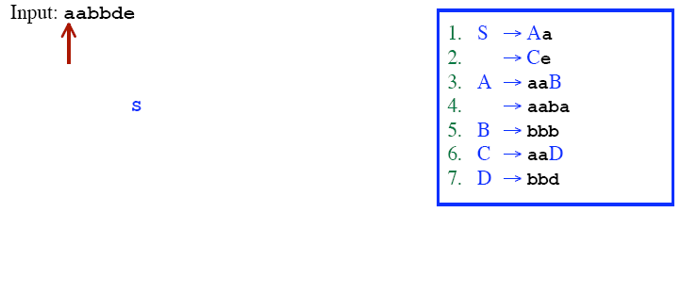
Recursive Descent Parsing (Backtracking)

Slide 5
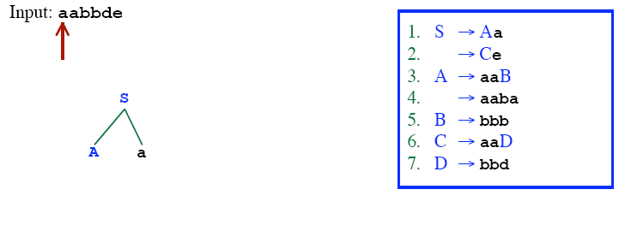
Recursive Descent Parsing (Backtracking)

Slide 6
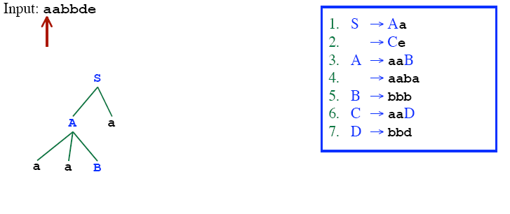
Recursive Descent Parsing (Backtracking)

Slide 7
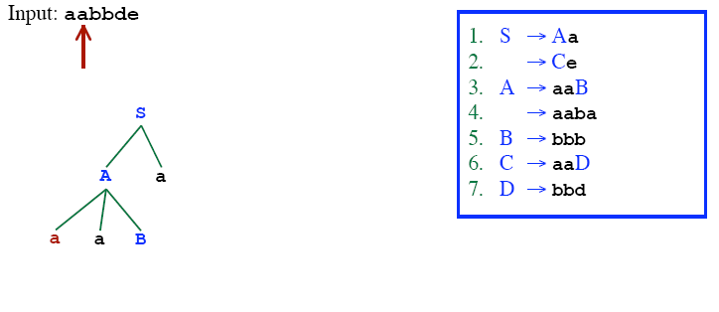
Recursive Descent Parsing (Backtracking)

Slide 8
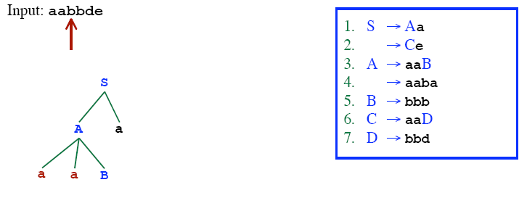
Recursive Descent Parsing (Backtracking)

Slide 9
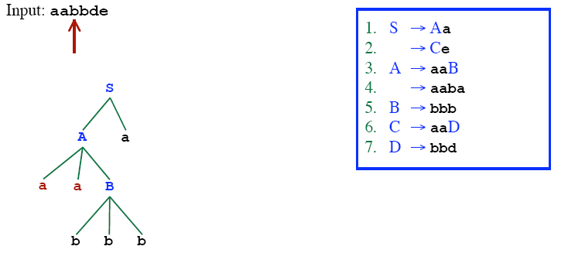
Recursive Descent Parsing (Backtracking)

Slide 10
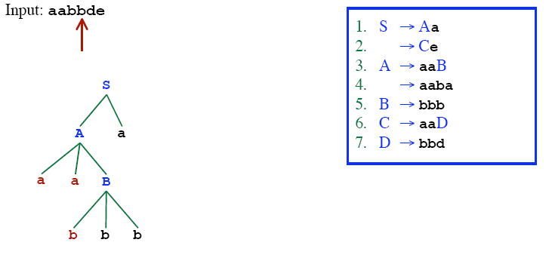
Recursive Descent Parsing (Backtracking)

Slide 11
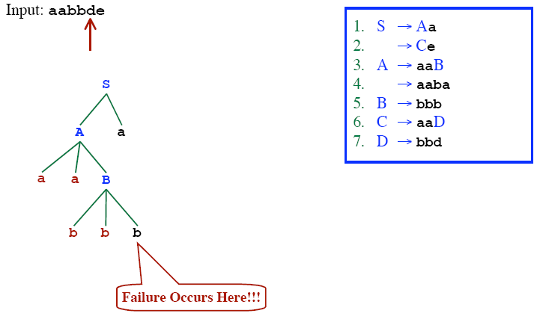
Recursive Descent Parsing (Backtracking)

Slide 12
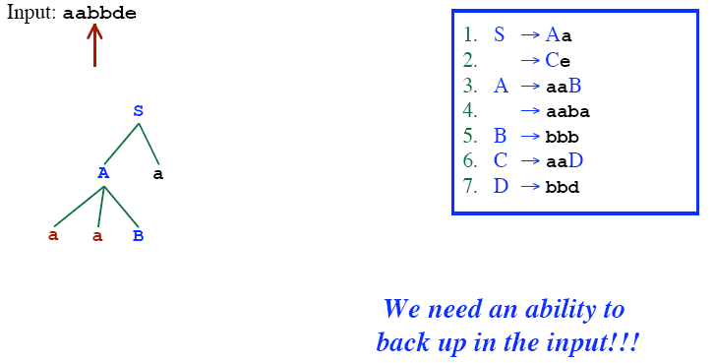
Recursive Descent Parsing (Backtracking)

Slide 13
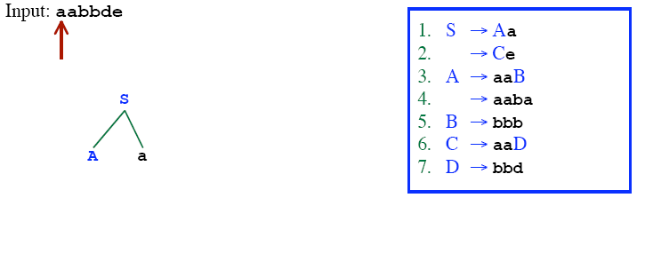
Recursive Descent Parsing (Backtracking)

Slide 14
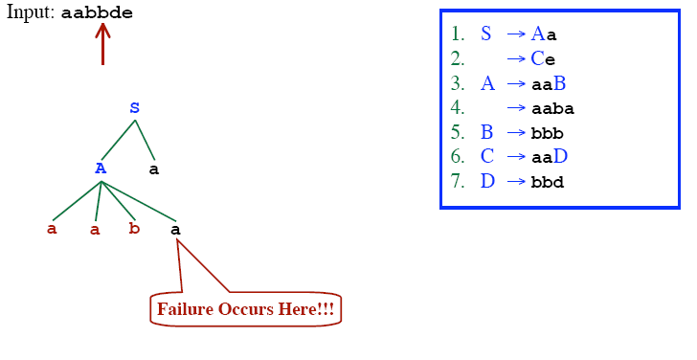
Recursive Descent Parsing (Backtracking)

Slide 15
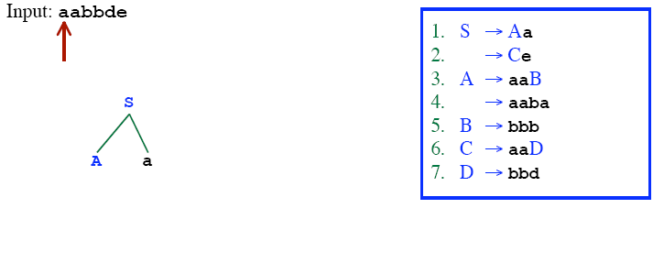
Recursive Descent Parsing (Backtracking)

Slide 16
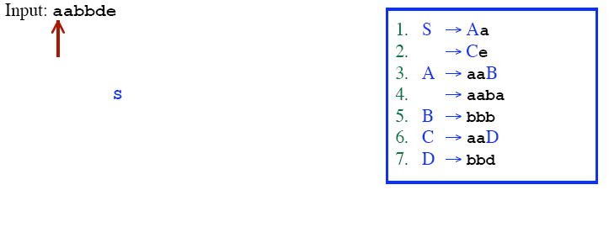
Recursive Descent Parsing (Backtracking)

Slide 17
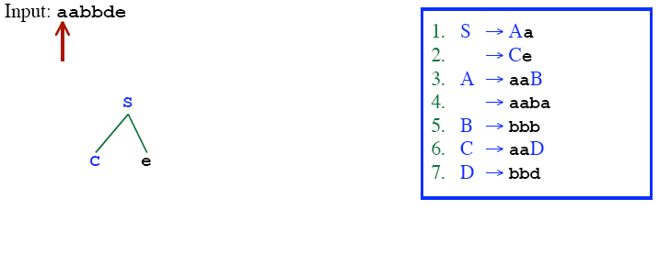
Recursive Descent Parsing (Backtracking)

Slide 18
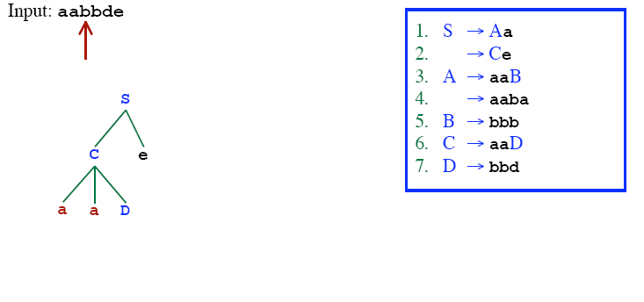
Recursive Descent Parsing (Backtracking)

Slide 19
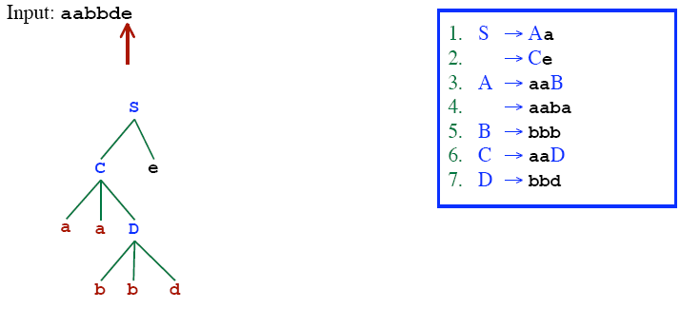
Recursive Descent Parsing (Backtracking)

Slide 20
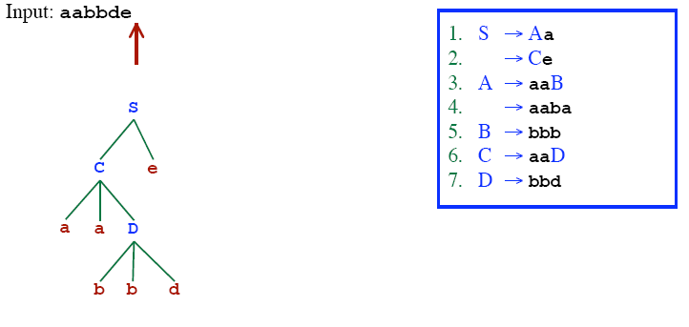
Recursive Descent Parsing (Backtracking)
Successfully parsed!!

Slide 21
Recursive-Descent Parsing Algorithm
A recursive-descent parsing program consists of a set of procedures – one for each non-terminal
Execution begins with the procedure for the start symbol
  Announces success if the procedure body scans the entire input
void A( ){
for (j = 1 to t){ /* assume there is t number of A-productions */
Choose a A-production, A_{j}→X₁X₂…X_{k};
for (i = 1 to k){
if (X_{i} is a non-terminal)
call procedure X_{i}();
else if (X_{i} equals the current input symbol a)
advance the input to the next symbol;
else backtrack in input and reset the pointer
}
}
}

Slide 22
Predictive Parser
When re-writing a non-terminal in a derivation step, a predictive parser can uniquely choose a production rule by just looking the current symbol in the input string.
A → α₁ | ... | α_{n} input: ... a .......
current token

Slide 23
Predictive Parser (example)
stmt → if ...... |
while ...... |
begin ...... |
for .....
When we are trying to write the non-terminal stmt, if the current token is if, we have to choose first production rule.
When we are trying to write the non-terminal stmt, we can uniquely choose the production rule by just looking the current token.
The key problem during predictive parsing is that of determining the production rule to be applied for a non-terminal.

Slide 24
Recursive Predictive Parsing
Each non-terminal corresponds to a procedure.
Ex: A → aBb (This is only the production rule for A)
proc A
{
- match the current token with a, and move to the next token;
- call ‘B’;
- match the current token with b, and move to the next token;
}

Slide 25
Recursive Predictive Parsing (cont.)
A → aBb | bAB
proc A {
case of the current token {
‘a’: - match the current token with a, and move to the next token;
- call ‘B’;
- match the current token with b, and move to the next token;
‘b’: - match the current token with b, and move to the next token;
- call ‘A’;
- call ‘B’;
}
}

Slide 26
Recursive Predictive Parsing (cont.)
When to apply ε-productions.
A → aA | bB | ε
If all other productions fail, we should apply an ε-production. For example, if the current token is not a or b, we may apply the ε-production.
Most correct choice: We should apply an ε-production for a non-terminal A when the current token is in the follow set of A (which terminals can follow A in the sentential forms).

Slide 27
FIRST and FOLLOW Functions
The construction of predictive parsers is aided by two functions associated with grammar: FIRST and FOLLOW
During top-down parsing these functions allow us to choose which production to apply, based on the next input symbol.
During panic-mode recovery, sets of tokens produced by FOLLOW can be used as synchronizing tokens.

Slide 28
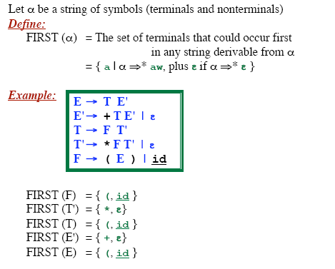
FIRST Function

Slide 29
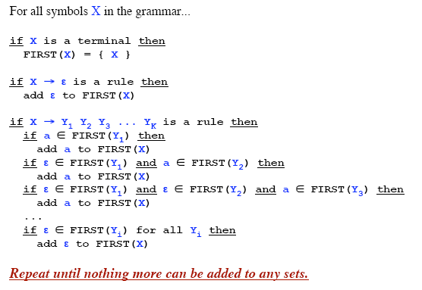
Computing the FIRST Function

Slide 30
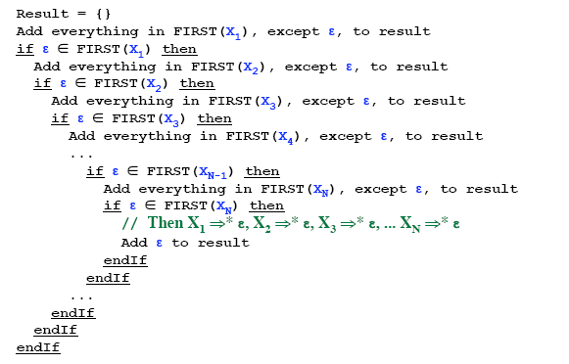
To Compute the FIRST(X1X2X3...XN)

Slide 31
First – Example(1)
P → i | c | n T S
Q → P | a S | b S c S T
R → b | e
S → c | R n | e
T → R S q
FIRST(P) = {i, c, n}
FIRST(Q) = {i, c, n, a, b}
FIRST(R) = {b, e}
FIRST(S) = {c, b, e}
FIRST(T) = {b, e}

Slide 32
First – Example(2)
S → a S e | S T S
T → R S e | Q
R → r S r | e
Q → S T | e
FIRST(S) = {a}
FIRST(R) = {r, e}
FIRST(T) = {r, a, e}
FIRST(Q) = {a, e}

Slide 33
FOLLOW Function
FOLLOW(A) is the set of terminals (including end marker of input - $) that may immediately follow non-terminal A in some sentential form.
FOLLOW(A) = {c | S ⇒⁺ …Ac…} ∪ {$} if S ⇒⁺ …A
For example, consider L ⇒⁺ (())(L)L, both ‘)’ and ‘$’ can follow L
NOTE: ɛ is never in FOLLOW sets

Slide 34
Computing FOLLOW(A)
If S is start symbol, put $ in FOLLOW(S)
For productions of the form A → αBβ, then
  Add FIRST(β) to FOLLOW(B) [except {ɛ}]
For productions of the form A → αB or A → αBβ
where FIRST(β) contains ɛ (i.e. b ⇒* ɛ), then
  Add FOLLOW(A) to FOLLOW(B)

Slide 35
FOLLOW – Example(1)
E → T E′
E′ → + T E′ | ɛ
T → F T′
T′ → * F T′ | ɛ
F → ( E ) | id
FIRST(E) = {(, id}
FIRST(E′) = {+, ɛ}
FIRST(T) = {(, id}
FIRST(T′) = {*, ɛ}
FIRST(F) = {(, id}}
FOLLOW(E) = {$}
FOLLOW(E′) =
FOLLOW(T) =
FOLLOW(T′) =
FOLLOW(F) =
Using rule #1
If S is start symbol, put $ in FOLLOW(S)
Assume the first non-terminal is the start symbol

Slide 36
FOLLOW – Example(1)
E → T E′
E′ → + T E′ | ɛ
T → F T′
T′ → * F T′ | ɛ
F → ( E ) | id
FIRST(E) = {(, id}
FIRST(E′) = {+, ɛ}
FIRST(T) = {(, id}
FIRST(T′) = {*, ɛ}
FIRST(F) = {(, id}}
FOLLOW(E) = {$, )}
FOLLOW(E′) =
FOLLOW(T) = {+}
FOLLOW(T′) =
FOLLOW(F) = {*}
Using rule #2
Productions of the form A → α B β,
  Add FIRST(β) – {ɛ} to FOLLOW(B)

Slide 37
FOLLOW – Example(1)
E → T E′
E′ → + T E′ | e
T → F T′
T′ → * F T′ | e
F → ( E ) | id
FIRST(E) = {(, id}
FIRST(E′) = {+, e}
FIRST(T) = {(, id}
FIRST(T′) = {*, e}
FIRST(F) = {(, id}}
FOLLOW(E) = {$, )}
FOLLOW(E′) = FOLLOW(E)
  = {$, )}
FOLLOW(T) = {+} ∪ FOLLOW(E′)
= {+, $, )}
FOLLOW(T′) = FOLLOW(T)
= {+, $, )}
FOLLOW(F) = {*} ∪ FOLLOW(T′)
= {*, +, $, )}
Using rule #3
3. For productions of the form A → αB or A → αBβ
where FIRST(β) contains ɛ (i.e. b ⇒* ɛ), then
  Add FOLLOW(A) to FOLLOW(B)

Slide 38
FOLLOW – Example(2)
S → ( A) | e
A → T E
E → & T E | e
T → ( A ) | a | b | c
FIRST(T) = {(, a, b, c}
FIRST(E) = {&, e}
FIRST(A) = {(, a, b, c}
FIRST(S) = {(, e}
FOLLOW(S) =
FOLLOW(A) =
FOLLOW(E) =
FOLLOW(T) =

Slide 39
FOLLOW – Example(2)
S → ( A) | e
A → T E
E → & T E | e
T → ( A ) | a | b | c
FIRST(T) = {(,a,b,c}
FIRST(E) = {&, e }
FIRST(A) = {(,a,b,c}
FIRST(S) = {(, e}
FOLLOW(S) = {$}
FOLLOW(A) = { ) }
FOLLOW(E) = FOLLOW(A) = { ) }
FOLLOW(T) = FIRST(E) ∪ FOLLOW(E) = {&, )}

Slide 40
FOLLOW – Example(3)
FOLLOW(C) =
FOLLOW(B) =
FOLLOW(S) = {$}
S → a S e | B
B → b B C f | C
C → c C g | d | e
FIRST(C) = {c,d,e}
FIRST(B) = {b,c,d,e}
FIRST(S) = {a,b,c,d,e}
Using rule #1
If A is start symbol, put $ in FOLLOW(A)
Assume the first non-terminal is the start symbol.

Slide 41
FOLLOW – Example(3)
FOLLOW(C) = {f,g}
FOLLOW(B) = {c,d,e}
FOLLOW(S) = {$,e}
S → a S e | B
B → b B C f | C
C → c C g | d | e
FIRST(C) = {c,d,e}
FIRST(B) = {b,c,d,e}
FIRST(S) = {a,b,c,d,e}
Using rule #2
Productions of the form A → α B β,
  Add FIRST(β) – {ɛ} to FOLLOW(B)

Slide 42
FOLLOW – Example(3)
FOLLOW(C) =
FOLLOW(B) =
FOLLOW(S) = { }
S → a S e | B
B → b B C f | C
C → c C g | d | e
FIRST(C) = {c,d,e}
FIRST(B) = {b,c,d,e}
FIRST(S) = {a,b,c,d,e}
_{{f,g} ∪ FOLLOW(B)}
_{= {c,d,e,f,g,$}}
_{{c,d,e} ∪ FOLLOW(S)}
_{= {c,d,e,$}}
_{$, e}
Using rule #3
3. For productions of the form A → αB or A → αBβ
where FIRST(β) contains ɛ (i.e. b ⇒* ɛ), then
  Add FOLLOW(A) to FOLLOW(B)

Slide 43
Predictive Parsing
Parser can “predict” which production to use
- By looking at the next few tokens
- No backtracking
Predictive parsers accept LL(k) grammars
- L means “left-to-right” scan of input
- L means “leftmost derivation”
- k means “predict based on k tokens of look-ahead”
In practice, LL(1) is used.
Also known as LL/LL(K) parser.

Slide 44
LL(1) Grammar
Previous definition:
  A grammar G is LL(1) iff. for all non-terminals A, each distinct pair of productions A → β and A → γ satisfy the condition FIRST(β) ∩ FIRST(γ) = ∅
  But what if A ⇒* ε?
Revised definition:
  A grammar G is LL(1) iff. for each set of productions like
  A → α₁ | α₂ | … | α_{n}
  1. .FIRST(α₁), FIRST(α₂), …, FIRST(α_{n}) are pairwise disjoint
  2. If α_{i} ⇒* ε then FIRST(α_{j}) ∩ FOLLOW(A) = ∅, ∀ 1≤j≤n, i≠j

Slide 45
Properties of LL(1) Grammars
No left-recursive grammar is LL(1)
No ambiguous grammar is LL(1)
Some languages have no LL(1) grammar
A ε–free grammar where each alternative expansion for A begins with a distinct terminal is a simple LL(1) grammar.
Example:
  S → aS | a
  is not LL(1) because FIRST(aS) = FIRST(a) = { a }
  S → aS´
  S´ → S | ε
  accepts the same language and is LL(1)

Slide 46
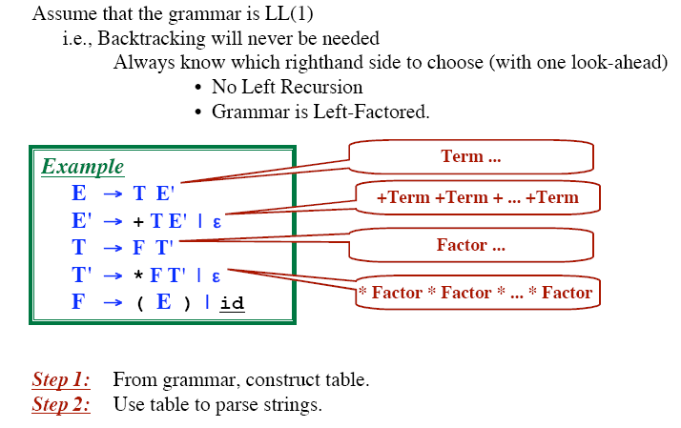
Table Driven Predictive Parsing

Slide 47
Construction of a LL(1) Parsing Table
Input: Grammar G
Output: Parsing table M
Method:
For each production A → α:
  For each terminal a in FIRST(α), add A → α to M[A,a]
  If ε is in FIRST(α):
    For each terminal b in FOLLOW(A), add A → α to M[A,b]
    If $ is in FOLLOW(A), add A → α to M[A,$]
Set each undefined entry of M to error
NB: If there exists M[A,a] with multiple entries, then G is not LL(1).

Slide 48
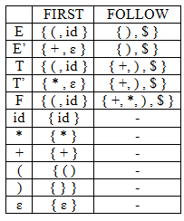
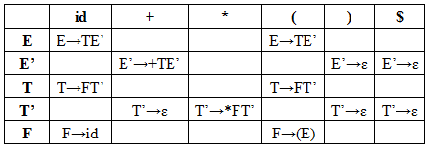
Example of Parsing Table Construction (1)
Given Grammar
E → TE’
E’ → +TE’ | ε
T → FT’
T’ → * FT’ | ε
F → (E) | id

Slide 49

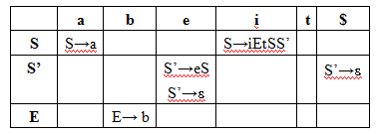
Example of Parsing Table Construction (2)
Given Grammar
S → iEtSS’| a
S’ → eS | ε
E → b
Ambiguity

Slide 50
Example of Parsing Table Construction (2) Cont…
The grammar is ambiguous as we have two entries corresponding to M[S’,e] containing S’→ ɛ and S’ → eS.
This ambiguity can be resolved if we choose S’ → eS, i.e. associating the else’s with the closest previous “then”.
This ambiguity will be solved if we use LL(2) parser, i.e. always see for the two input symbols. When input is ‘e’ then it looks at next input. Depending on the next input we choose the appropriate rule.

Slide 51
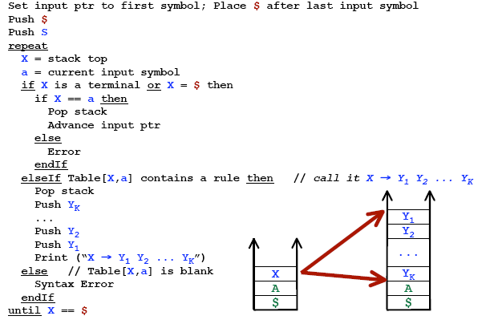
Predictive Parsing Algorithm

Slide 52
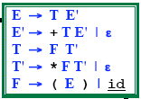
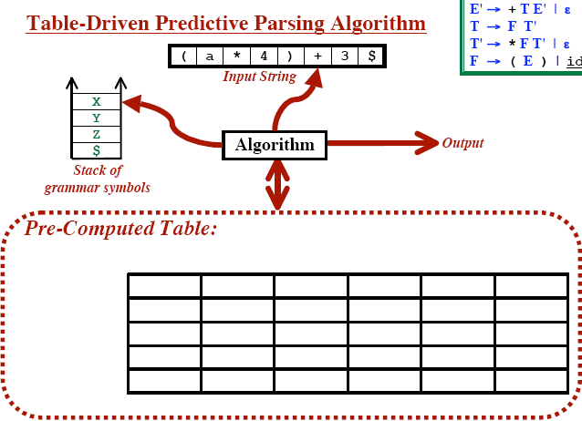
Table Driven Predictive Parsing

Slide 53
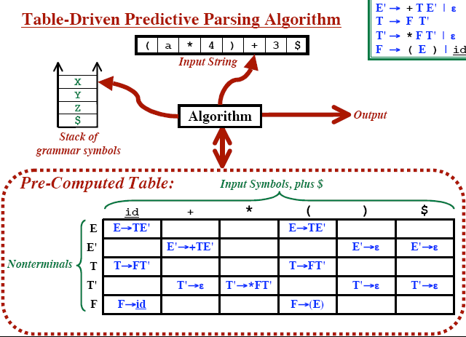
Table Driven Predictive Parsing

Slide 54
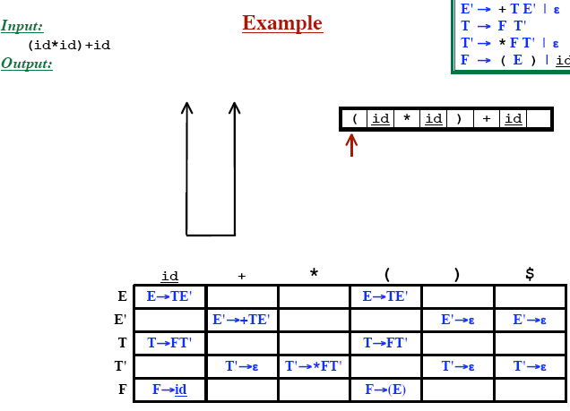
Table Driven Predictive Parsing

Slide 55
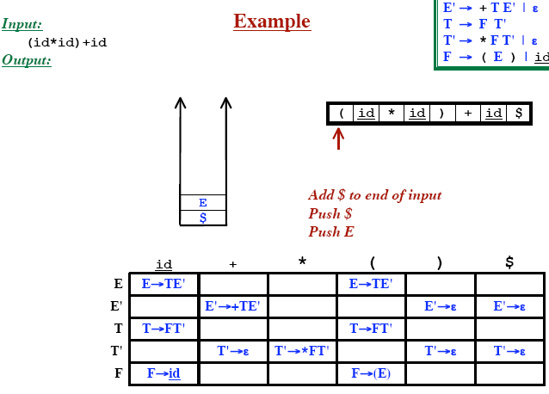
Table Driven Predictive Parsing

Slide 56
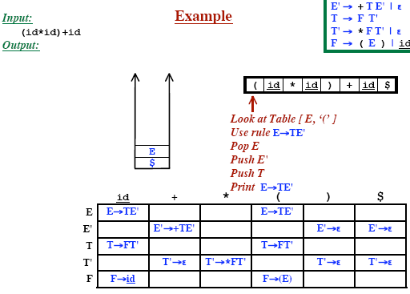
Table Driven Predictive Parsing

Slide 57
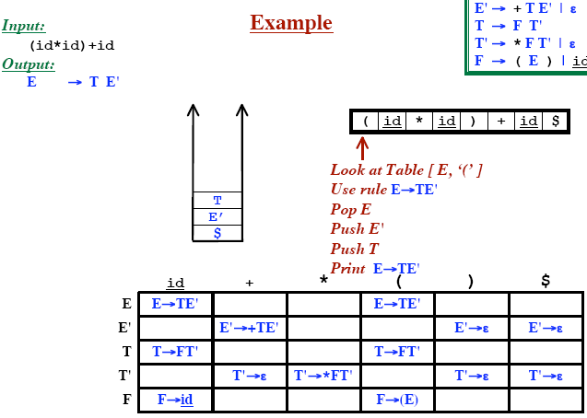
Table Driven Predictive Parsing

Slide 58
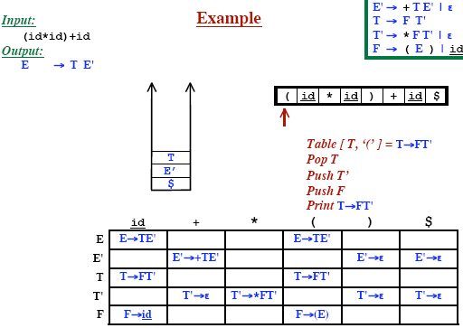
Table Driven Predictive Parsing

Slide 59
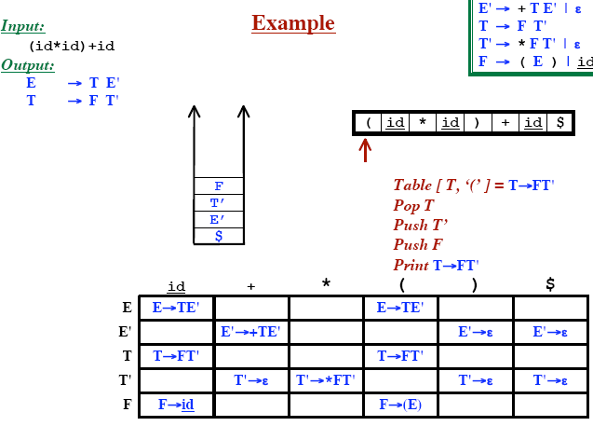
Table Driven Predictive Parsing

Slide 60
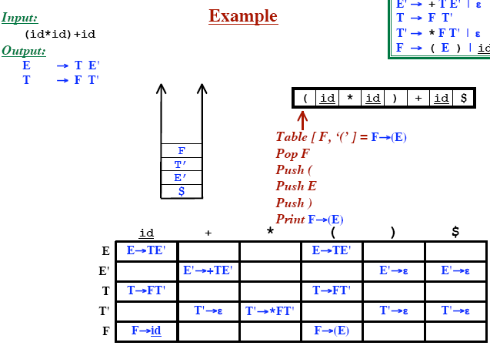
Table Driven Predictive Parsing

Slide 61
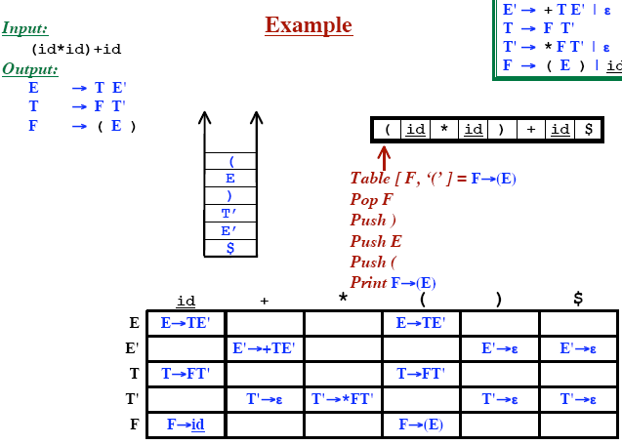
Table Driven Predictive Parsing

Slide 62
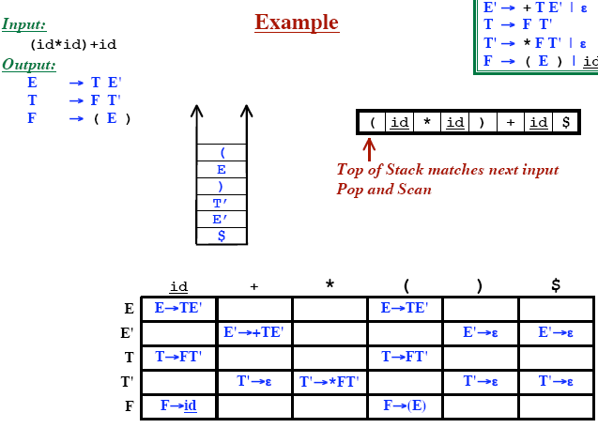
Table Driven Predictive Parsing

Slide 63
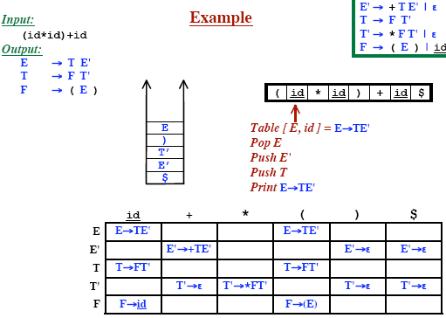
Table Driven Predictive Parsing

Slide 64
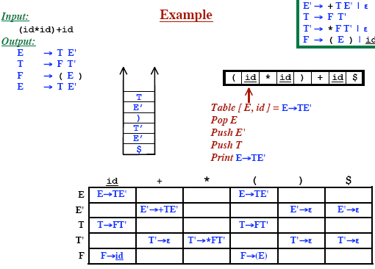
Table Driven Predictive Parsing

Slide 65
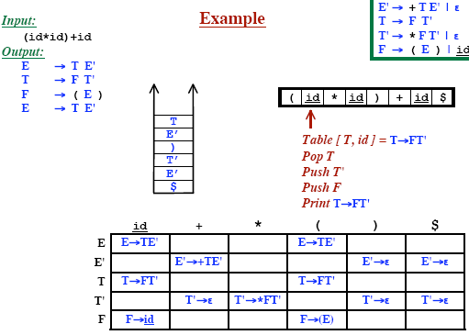
Table Driven Predictive Parsing

Slide 66
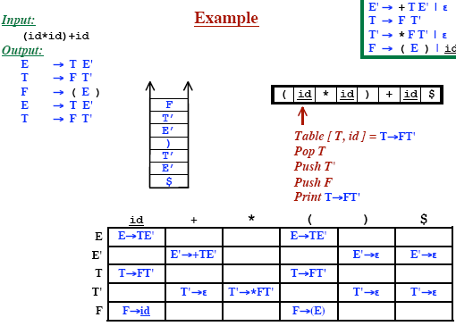
Table Driven Predictive Parsing

Slide 67
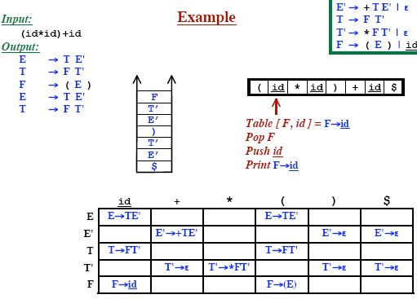
Table Driven Predictive Parsing

Slide 68
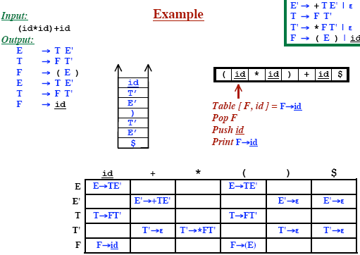
Table Driven Predictive Parsing

Slide 69
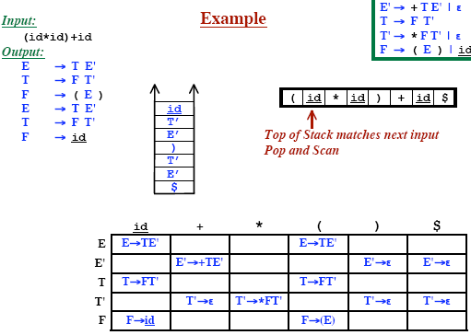
Table Driven Predictive Parsing

Slide 70
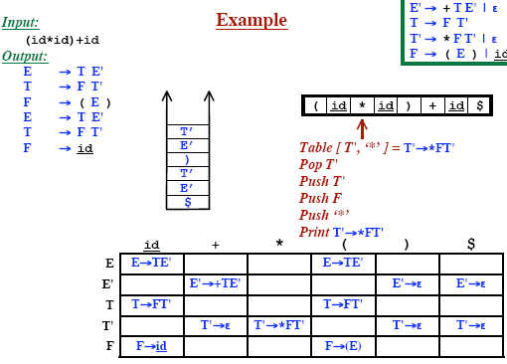
Table Driven Predictive Parsing

Slide 71
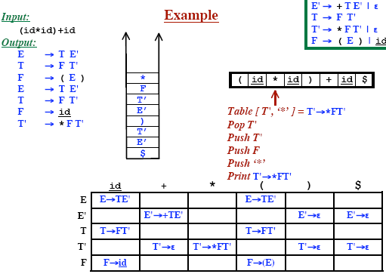
Table Driven Predictive Parsing

Slide 72
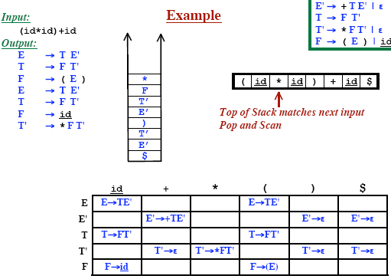
Table Driven Predictive Parsing

Slide 73
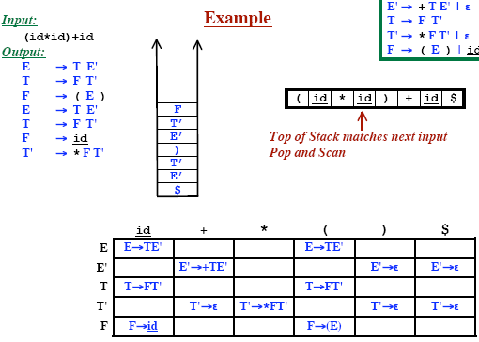
Table Driven Predictive Parsing

Slide 74
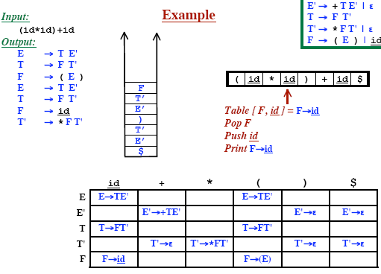
Table Driven Predictive Parsing

Slide 75
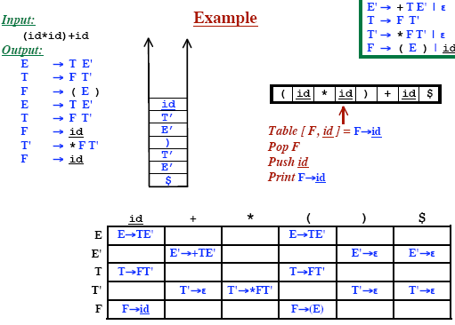
Table Driven Predictive Parsing

Slide 76

Table Driven Predictive Parsing

Slide 77

Table Driven Predictive Parsing

Slide 78

Table Driven Predictive Parsing

Slide 79

Table Driven Predictive Parsing

Slide 80

Table Driven Predictive Parsing

Slide 81

Table Driven Predictive Parsing

Slide 82

Table Driven Predictive Parsing

Slide 83

Table Driven Predictive Parsing

Slide 84

Table Driven Predictive Parsing

Slide 85

Table Driven Predictive Parsing

Slide 86

Table Driven Predictive Parsing

Slide 87

Table Driven Predictive Parsing

Slide 88

Table Driven Predictive Parsing

Slide 89

Table Driven Predictive Parsing

Slide 90

Table Driven Predictive Parsing

Slide 91

Table Driven Predictive Parsing

Slide 92

Table Driven Predictive Parsing

Slide 93

Table Driven Predictive Parsing

Slide 94

Table Driven Predictive Parsing

Slide 95

Table Driven Predictive Parsing

Slide 96

Table Driven Predictive Parsing

Slide 97

Table Driven Predictive Parsing

Slide 98

Table Driven Predictive Parsing

Slide 99

Table Driven Predictive Parsing

Slide 100

Table Driven Predictive Parsing

Slide 101






Reconstructing the Parse Tree

Slide 102


Reconstructing the Parse Tree

Slide 103


Reconstructing the Parse Tree

Slide 104
Error Recovery
When Do Errors Occur? Recall Predictive Parser Function:
a
+
b
$
Input
Stack
X
Predictive Parsing Program
Output
Y
Z
Parsing Table M[A,a]
$
If X is a terminal and it doesn’t match input.
If M[X, Input] is empty – No allowable actions

Slide 105

Error Recovery (Cont..)

Slide 106

Error Recovery: Skip Input Symbols

Slide 107

Error Recovery: Pop The Stack

Slide 108

Error Recovery: Panic Mode

